Slide 1
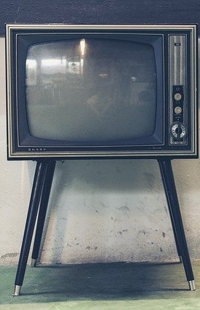
LECTURE SEVEN: COMPATIBILITY AND COLOUR TELEVISION FUNDAMENTALS
ET 8105 – Television Systems

Slide 2
Introduction
Success in the deployment of monochrome TV triggered other researches in the transmission of colour pictures.
The scientists efforts were successful and it became known that the transmission and reception of colours could be a straight and simple system.
But it could not happen so because of the necessity to make the colour system compatible with the existing monochrome system.
It was due to this compatibility requirement that regular colour TV were deployed later than expected.

Slide 3
Compatibility
Compatibility of colour TV system with the then existing monochrome TV system meant that, colour transmission should be received as black and white picture in a monochrome receiver without any change in the receiver design.
Also, it meant that monochrome transmission be received as black and white picture in a colour receiver.
The figure in the next slide illustrate the concept of compatibility.

Slide 4
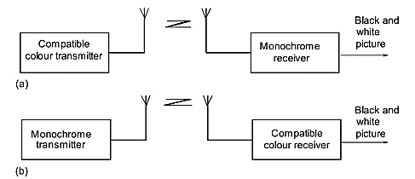
Compatibility between colour and monochrome systems

Slide 5
Conditions to be Fulfilled for Compatibility
Reception of colour transmission in a monochrome receiver a black and white picture should not require any change in the circuits of the monochrome receiver.
Baseband of colour signals (about 1.5 MHz) should be accommodated in the baseband of the monochrome system without increasing the overall bandwidth.
The main video carrier frequency for colour transmission should remain the same as for monochrome transmission.
The location and spacing of the video and audio carrier frequencies in the radio frequency spectrum and overall channel width should remain the same in colour transmission as in monochrome transmission.

Slide 6
The colour signal should be transmitted in such a form that it can be ignored by a monochrome receiver, but it should be available in appropriate proportions of three primary colours at the input of the colour picture tube in colour receivers.
Scanning and sync requirements of colour system should be the same as for monochrome system.
Final modulation of the video carrier and audio carrier should be the same in colour system as in monochrome system so that the RF amplifier, mixer, IF amplifiers and the video detector stage are in both the systems.
Black and white picture should not be affected by colour subcarrier produced locally in a colour receiver.

Slide 7
Achievement of Compatibility
The techniques used in compatible colour TV are mentioned hereafter.
The original colour in the picture is converted into three primary colours with the help of dichroic mirrors or prisms and filters.
The brightness contained in these colours is converted into three video signals by camera tubes.
Luminance (or brightness) signal called Y signal is derived from the three colour signals by using a resistive matrix.
The output of this matrix is of the same voltage which a monochrome camera would have produced
Instead of using basic colour signals R, G and B for transmission, colour difference signals are used, that is R-Y, G-Y and B-Y.

Slide 8
Y signal along with the synchronising pulses and the subcarrier modulated by R–Y and B–Y signals are added and the resultant colour composite video signal (Y+C) is used to modulate the main video carrier, using AMVSB method of modulation.
FM signal (modulated by audio) is obtained in the same way as in monochrome system
A common antenna is used for transmission as in the monochrome system.
At the receiver, RF amplifier, mixer, IF stages and video detector are common in both monochrome and colour receivers
There is no change in video amplifiers of a monochrome receiver, only the colour receiver needed a new block called colour decoder.

Slide 9
After the video detector, Y signal is separated from C signal. It is amplified by a wideband video amplifier in monochrome as well as in the colour receiver.
In a monochrome receiver, the chroma signal, being AMSC type, cannot be detected in the absence of the colour subcarrier, hence only Y signal is detected, amplified and fed to the monochrome picture tube.
In the colour receiver, the colour detector block detects the colour signals. The colour difference signals are added with the Y signal to produce the original R, G and B voltages.
For receiving monochrome transmission, the colour receiver will not get the colour difference signals and so the stages of the colour receiver which give R, G and B voltages will give only Y voltage.

Slide 10
Colour Camera Tubes
A colour at any pixel in the colour picture can be considered consisting of three primary colours, red, green and blue.
The function of a colour camera is to convert brightness of each primary colour in a picture into electrical voltage pixel by pixel.
The camera tubes are so adjusted that the voltage pertains to the actual brightness present in the colour and not on the brightness as perceived by the eye.
Thus the signals so obtained are the chrominance signals.
This is made possible by two types of colour camera tubes: (1) Three-tube camera (2) Single-tube camera.

Slide 11
Three-Tube Camera
It consists of three identical camera tubes, as shown in the next figure.
Each tube being the same as used in monochrome TV transmitter
There tubes may be vidicon or plumbicon or any other modified version.
The only difference is that, in a monochrome camera tube, video voltage is proportional to the sensitivity of the eye for the colours of the pixels, while in the colour camera the video voltage represents the absolute (actual) intensity present in the pixels of the picture.
For reproducing the colours, the light incident on the camera tube is first broken into three primary colours with the help of dichroic mirrors of prisms and colour filters.

Slide 12
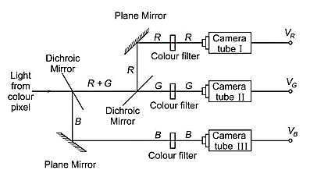
Production of colour signals by three-tube camera

Slide 13
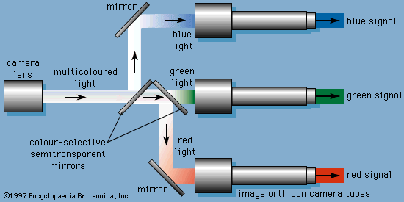

Slide 14
The dichroic mirror is a precision optical device capable of reflecting one colour while transparent to others.
Prisms can also serve the same purpose due to different refractions for different colours
The three colour beams strike the three camera tubes through the colour filters.
The colour filter allows light of that colour only for which it has been designed.
The camera tube which receives red light from the red filter will give video signal pertaining to the brightness present in the red colour.
The terms V_{R}, V_{G} and V_{B} represent signal voltages pertaining to red, green and blue colours, respectively.

Slide 15
Single-Tube Camera
The single-tube colour camera uses only one 17 mm vidicon tube.
Plumbicon camera tube has also been successfully modified to function as a single-tube colour camera.
In this type of camera tube, the face plate contains very close spaced stripes of red, green and blue colours which act as colour filters.
The target also has corresponding stripes as shown in the next picture.
The target converts colour signals into the respective charge signal pattern.

Slide 16
The scanning beam produces video signals across the respective load resistors.
Hence we get video signals corresponding to red, green and blue colour. Thus we get the same signals as we get in a three-tube camera.
As the single-tube camera uses only one tube instead of three tubes, it is quite portable and is very suitable for electronic news gathering
It is also suitable of use as domestic colour camera.

Slide 17
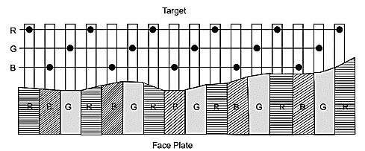
Single-tube colour camera

Slide 18
Adjustment of White Balance in Colour Camera
Video signals in a colour camera tube represent voltages directly proportional to the intensity of light or brightness of the primary colours of which the actual colour of a pixel is made of.
Voltage outputs of the colour camera tube should not depend on the sensitivity of the eye for the respective primary colours.
This is made possible by adjusting the gain controls of individual colour cameras so that for equal intensity of red, green and blue, the outputs are equal in all the three camera tubes.
For example, 1 volt for each instead of 0.3 volt for red, 0.59 volt for green and 0.11 volt for blue

Slide 19
It should remain the same whether the scene is being shot outdoors in bright sun light or indoors in artificial light.
The adjustments made in colour camera tubes to ensure fulfillment of the above conditions is called white balance adjustment.
Luminance signal Y will be obtained by a resistive matrix and would be 1 V for white.
As R, B and G are 1 V each, and Y is also 1V, each colour difference signal would be zero for white.
Modern TV cameras make white balance adjustments automatically in the actual light to be used for shooting.
There is an autowhite button for this purpose. The camera is pointed at a white card and then the autowhite button is pressed.

Slide 20
Luminance Signal
When light at a point in a picture is converted into a video signal by a monochrome camera tube, the tube senses only the brightness contained at that point irrespective of colour and that too in accordance with the sensitivity of the eye.
This voltage is called luminance signal.
Suppose the monochrome camera is so adjusted that we get 1 V for a white scene (i.e. red, blue and green colours are in equal quantity, say one lumen each), it is the luminance signal.
If the same white scene is sensed by the colour cameras (one getting red, the other green and the third, blue light), we get 1V in each camera.
Then these will be the chrominance signals, and not the luminance signal.

Slide 21
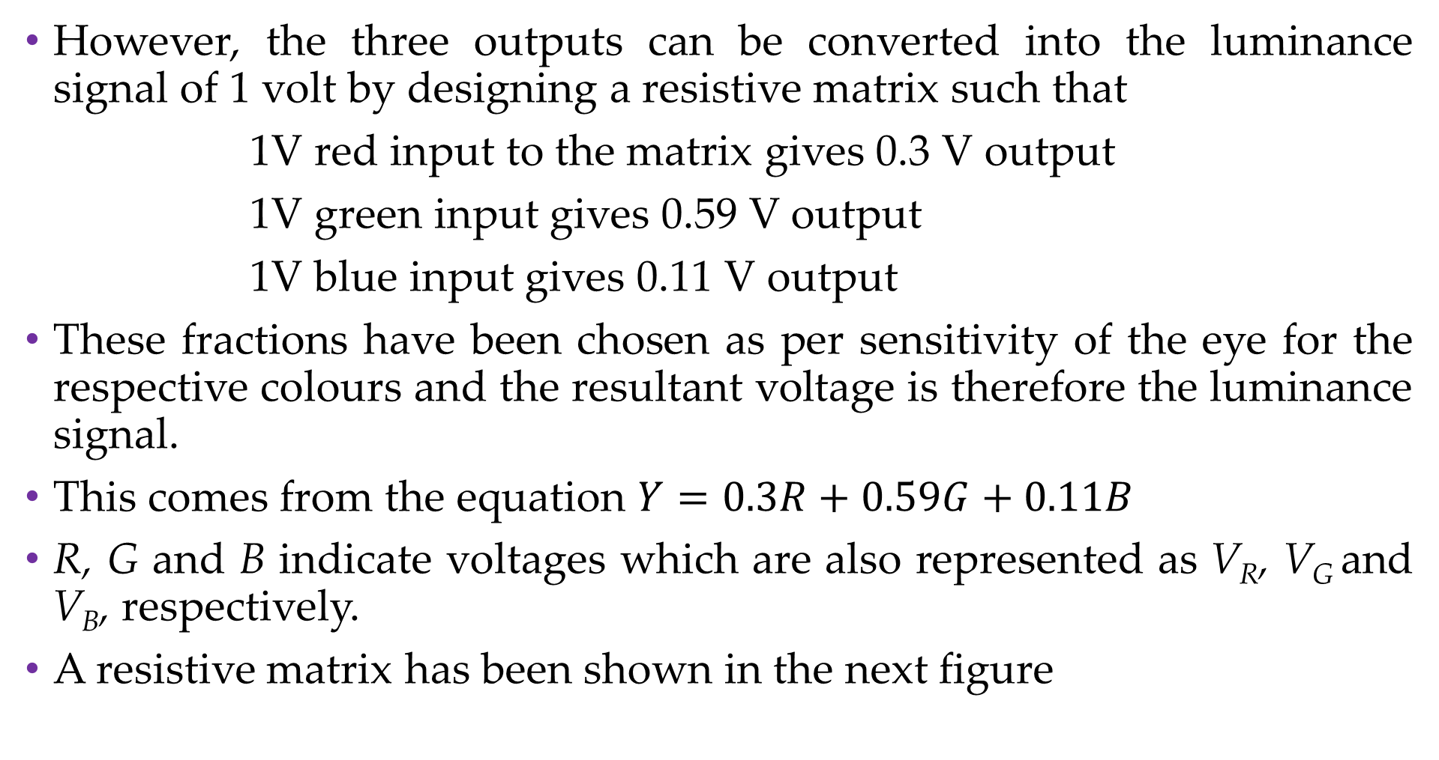
However, the three outputs can be converted into the luminance signal of 1 volt by designing a resistive matrix such that
1V red input to the matrix gives 0.3 V output
1V green input gives 0.59 V output
1V blue input gives 0.11 V output
These fractions have been chosen as per sensitivity of the eye for the respective colours and the resultant voltage is therefore the luminance signal.
This comes from the equation $Y=0.3R+0.59G+0.11B$
R, G and B indicate voltages which are also represented as V_{R}, V_{G} and V_{B}, respectively.
A resistive matrix has been shown in the next figure

Slide 22
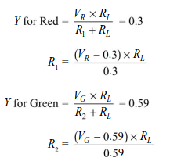
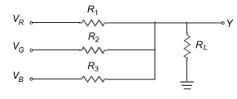
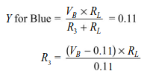
Resistive matrix for obtaining luminance signal

Slide 23
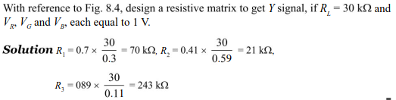
Example 01

Slide 24
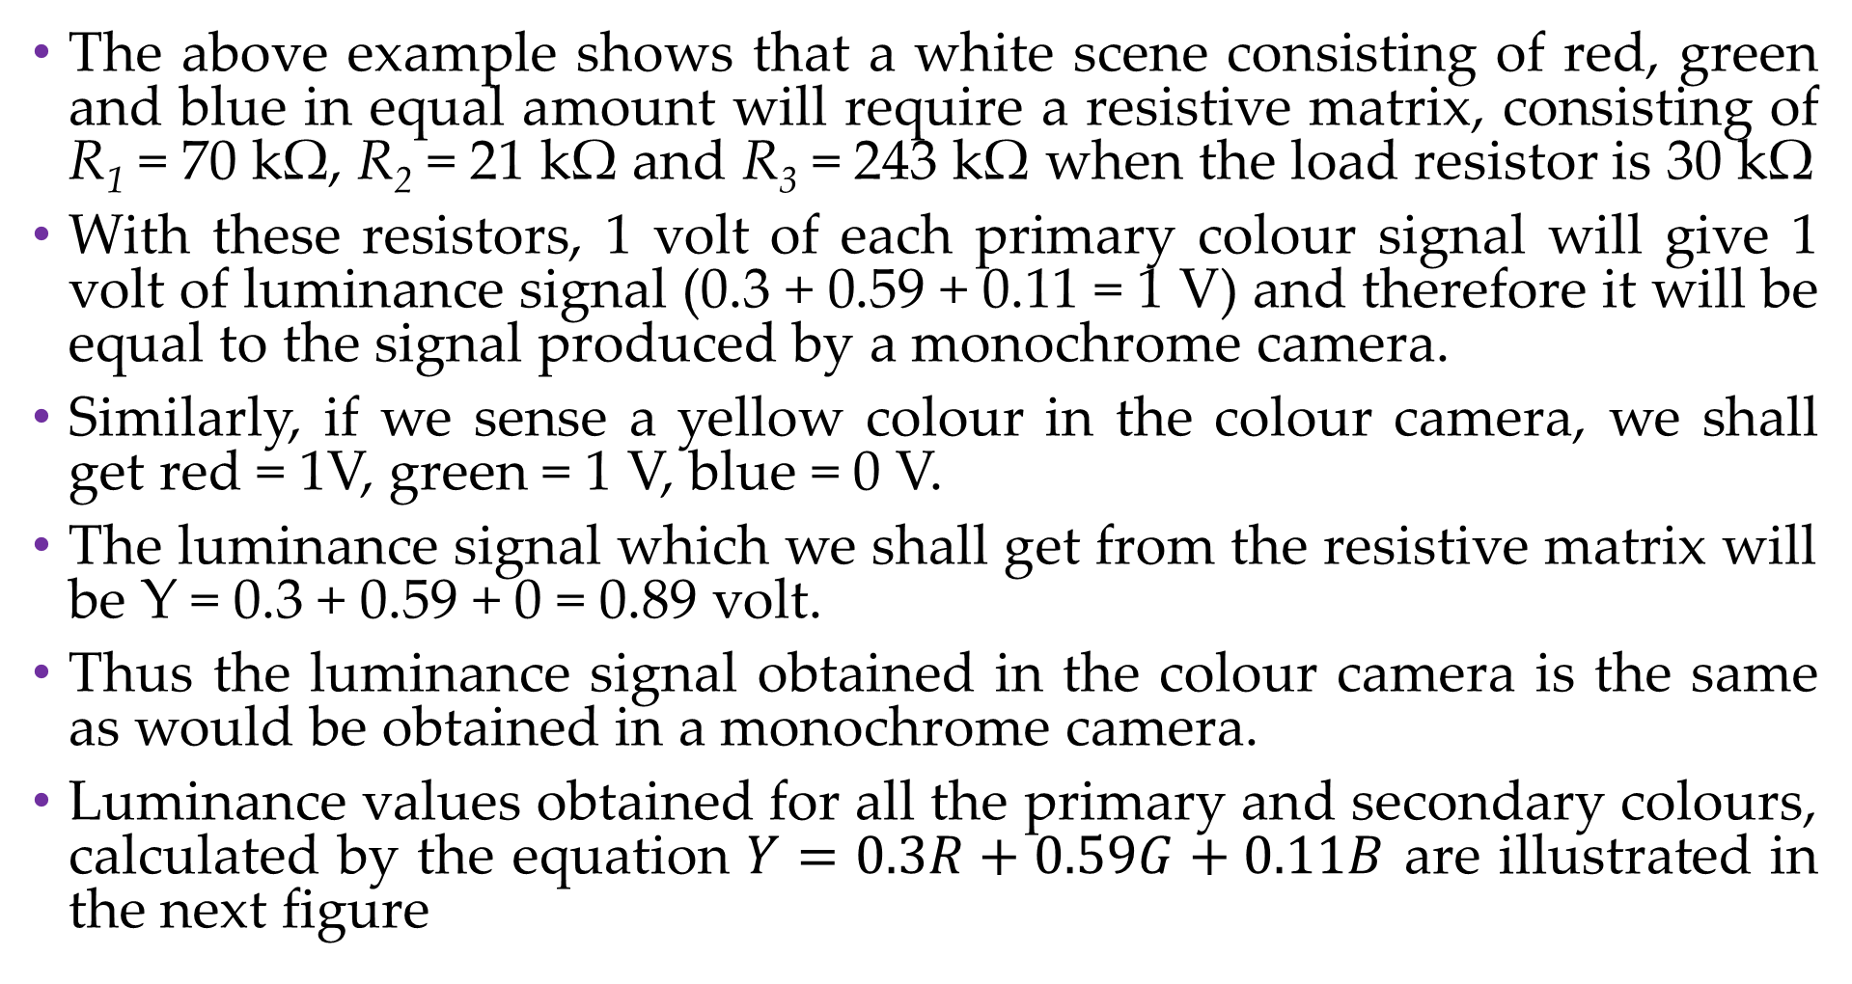
The above example shows that a white scene consisting of red, green and blue in equal amount will require a resistive matrix, consisting of R₁ = 70 kΩ, R₂ = 21 kΩ and R₃ = 243 kΩ when the load resistor is 30 kΩ
With these resistors, 1 volt of each primary colour signal will give 1 volt of luminance signal (0.3 + 0.59 + 0.11 = 1 V) and therefore it will be equal to the signal produced by a monochrome camera.
Similarly, if we sense a yellow colour in the colour camera, we shall get red = 1V, green = 1 V, blue = 0 V.
The luminance signal which we shall get from the resistive matrix will be Y = 0.3 + 0.59 + 0 = 0.89 volt.
Thus the luminance signal obtained in the colour camera is the same as would be obtained in a monochrome camera.
Luminance values obtained for all the primary and secondary colours, calculated by the equation $Y=0.3R+0.59G+0.11B$ are illustrated in the next figure

Slide 25
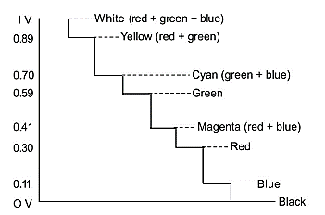
Staircase diagram showing luminance of colours

Slide 26
Chrominance Signal
When light from a pixel falls on a colour camera, the composite colour of the pixel is broken into three primary colours which produce video signal voltages, R, G, and B volts proportionate to the intensity present in the red, green, and blue light, respectively.
These three voltages taken individually represent primary colours present in the composite hue of the pixel (because each camera receives only a particular primary colour)
They also represent saturation of the colours.
These three signals are called chrominance signals as they are related to the colour or hue of the concerned pixel

Slide 27
However, for the sake of compatibility with the black and white TV system, the colour signals are not transmitted as such, but they are transmitted by converting then into colour difference signals.
There would be three colour difference signals: B–Y, R–Y and G–Y
These can be obtained by inverting the Y signal and adding the inverted Y (i.e. –Y ) to the primary colour signals.
Out of the three colour difference signals, only two (B-Y and R-Y) are needed to be transmitted and the third signal, G-Y is obtained locally in the receiver.
The production of colour difference signals is shown in the next figure.

Slide 28
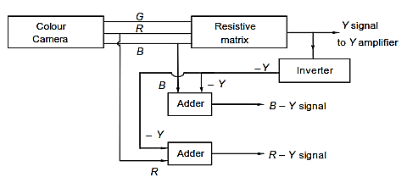
Production of colour difference signals

Slide 29
In TV, the two colour difference signals produced as above and duly weighted, modulate a subcarrier and the modulated subcarrier contains all the information about hue and saturation.
It is designated as chroma (C) signal.
The C signal is used as a baseband signal to modulate the main video carrier.

Slide 30
Colour Difference Signal Actually Transmitted
Out of the three colour difference signals, if only two of them are transmitted, the third one can be obtained locally in the receiver from the two transmitted.
A single carrier can be easily modulated by two signals by using quadrature phase modulation technique where by carrier is at 0˚ phase for getting modulated by B-Y signal and at 90˚ phase for R-Y signal.
The circuit would have become complex if a single carrier was required to be modulated by all the three signals
G -Y is not used in the modulation process

Slide 31
The Colour Diﬀerence Signal which is not Transmitted
G-Y colour signal is not transmitted, as it can be produced locally in the receiver easily by passing the available signals B-Y and R-Y through a resistive matrix.
The other colour difference signals (i.e. B-Y or R-Y) cannot be produced by a resistive matrix.
To understand this, let us determine the relationship between the colour difference signals.

Slide 32
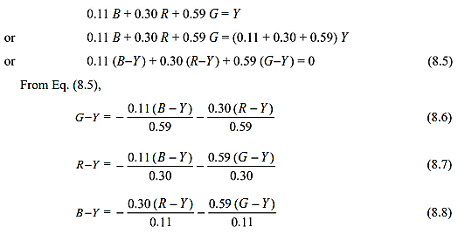

Slide 33
A resistive matrix cannot amplify the inputs but can reduce them.
For getting G-Y, the coefficients of inputs are 0.11/0.59 and 0.3/0.59, which are only a fraction and so can be achieved by a resistive matrix.
R-Y and B-Y cannot be obtained from a resistive matrix because of the coefficient 0.59/0.3 for R-Y and the coefficients 0.3/0.11 and 0.59/0.11 for B-Y are grater than 1.
This is the reason why only G-Y can be obtained locally from the known values of R-Y and B-Y with the help of a simple resistive matrix, and hence it is not transmitted.

Slide 34
Weighting Factors for Colour Difference Signals
Chroma signal is added to the Y signal for finally modulating the main video carrier.
This addition of chroma signal to the Y signal causes the resultant signal to exceed the peak level of the carrier for undiluted colours.
It means the modulation becomes more than 100%, resulting in severe distortion of colours.
Lets see the following examples

Slide 35
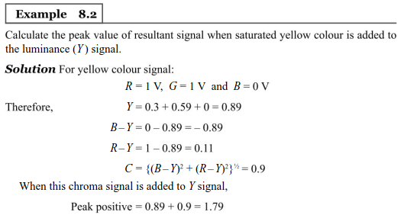

Slide 36
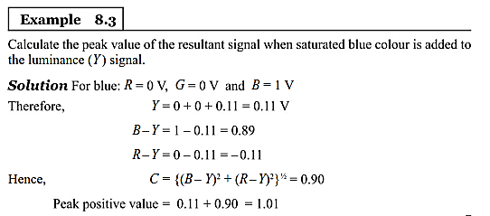

Slide 37
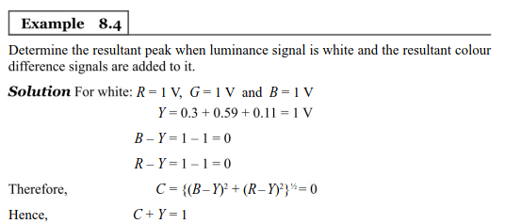

Slide 38
For examples 8.2 and 8.3, the peak exceeds 1 V (peak of the carrier) and hence modulation is more than 100%
For example 8.4, there is no over-modulation as the signal is white.
Thus, it can be shown that the modulation in case of all saturated colours is more than 100%
Thus, to check over-modulation, it is necessary to reduce the amplitude of B-Y and R-Y colour difference signals (which forms the chroma signal) before modulating the colour subcarrier.
The example of reducing factors or the weighting factors for PAL colour system are as follows
Weighting factor for B-Y = 0.493
Weighting factor for R-Y = 0.877

Slide 39
The weighted B-Y signal is called U signal and the weighted R-Y signal is called V signal.
Thus
U = 0.493 (B-Y)
V = 0.877 (R-Y)
Similarly there are weighting factors for colour signals in NTSC system and in SECAM system.
The above weighting factors will also give some over-modulation for saturated colours, but this is acceptable, because for most of the time, colours are unsaturated and further reduction will cause loss in power.
Consider the next example

Slide 40
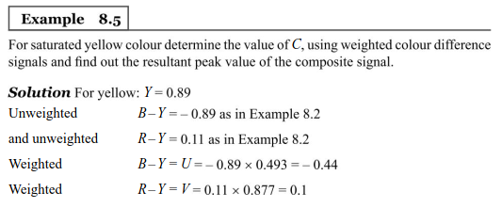


Slide 41
The above example shows that the peak value is reduced from 1.79 to 1.34
This is for saturated colours.
For unsaturated colours it will be further reduced and most of the time it may be less than 1, giving undistorted colours.

Slide 42
Distinction Between Luminance and Chrominance Signals
A signal obtained by colour camera tubes and dully processed for transmission as new baseband signal (AMSC sidebands of a carrier) is called chrominance signal or chroma signal and is represented by letter C.
The signal obtained by a monochrome camera tube or the signal obtained from the output of a resistive matrix used with colour camera tubes is called luminance signal.
In colour systems the luminance signal is represented by the letter Y.
In monochrome transmitter and receiver, only Y signal is used but in colour transmitter and receiver, both Y and C are used for achieving compatibility between colour and monochrome systems.

Slide 43
Colour Encoders
The weighted colour difference signals are made to modulate a subcarrier.
The modulated subcarrier is called chroma signal.
The circuit which produces chroma signal is called colour encoder.
Three types of colour encoders have been developed
NTSC System – In this the duly weighted colour difference signals, called I and Q signals appear simultaneously and maintain the mutual phase difference of +90˚ on each scanning line.
Modulation technique is AMSC

Slide 44
PAL System – In this the duly weighted colour difference signals, called U and V signals appear simultaneously and maintain 90˚ phase difference between each other, but one scanning line V is +90˚ away from U and on the next line it is -90˚ away from U
Modulation technique is AMSC
SECAM System – In this, duly weighted colour difference signals, called D_{B} and D_{R}, do not appear simultaneously on any line. If D_{B} appears on one line, then D_{R} appears on the next line.
Hence, the question of phase difference does not arise in this case
The modulation technique used is FM
These three encoding systems will be described firther in the next lecture

Slide 45
Production of Chroma Signal
The two weighted colour difference signals I and Q in NTSC system and U and V in PAL system require separate AMSC modulators.
The same subcarrier is used for both modulators, but one uses subcarrier in phase (0˚ phase difference), while the other modulator uses the subcarrier in quadrature phase (90˚ phase difference)
The AMSC modulators are called colour encoders.
The outputs of two modulators are added vectorially to get the resultant chrominance (or chroma signal, denoted by C)
Chroma signal is represented by amplitude and phase angle.
Amplitude denotes saturation and phase angle denotes hue of the resultant colour

Slide 46
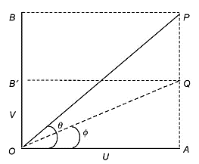
Representation of the resultant chroma signal

Slide 47
Colour Composite Video Signal
The chrominance signal is finally added to the luminance signal along with blanking and sync pulses and colour burst signal
The resultant is called colour composite video signal (CCVS)
This composite signal modulates the main video carrier using AMVSB technique as in the case of monochrome transmitter.
As the chroma signal is of AMSC modulation, it is necessary to generate the subcarrier signal locally in the receiver to detect baseband signals from the AMSC signals.
The presence of luminance signal in the transmitted wave makes it possible for the monochrome receiver to receive the brightness signal and to produce black and white picture.

Slide 48
U and V signals are recovered from the chroma signal in the colour receiver (but cannot be detected in a monochrome receiver).
These signals are de-weighted to get B-Y and R-Y signals
G-Y signal is obtained by a resistive matrix.
Finally, Y is added to the colour difference signals in the colour receiver to get the respective R, G and B voltages.
Thus, the original voltages produced by the colour camera tube are obtained in the colour receiver.
These voltages activate phosphor elements of the colour picture tube in such a manner that R glows only red phosphor, G only green phosphor and B only blue phosphor elements, reproducing the original colour picture on the screen

Slide 49
Interleaving of Chroma Signals in Between Monochrome Signals
In the scanning process, there is an interval of 20 ms between the odd and even fields on interlaced scanning.
For low resolution areas, where the pixels do not change for long, repetition of the scanning lines and fields will cause concentration of high energy in the form of bundles or clusters of energy.
For high resolution areas also where the pixels change energy quickly, repetitive scanning will form clusters of energy, but energy content would be low, almost negligible.
High resolution pertains to 5 MHz which is equal to 320 times scanning frequency (f_{H} = 15,625 Hz)

Slide 50
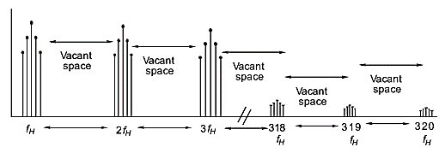
While energy is concentrated at the spots pertaining to the harmonics of f_{H}, the energy content goes on decreasing as the harmonic number increases, being quite high at f_{H}, 2f_{H} and negligibly small at 319f_{H} and 320f_{H}
Between any two consecutive harmonics, there are vacant spaces or slots where there is no monochrome energy. The next figure illustrates the scenario
Clustering of monochrome energy due to repeated scanning of pixels

Slide 51
The vacant spaces are occupied by the colour subcarrier (modulated by colour difference signals)
This process is called interleaving.
The frequency of the colour subcarrier is so chosen that it is near the upper end (5 MHz in CCIR B and 4.2 MHz in CCIR M system) of video bandwidth.
The energy of the chroma signal is also concentrated in bundles, but the highest energy bundle is at the colour subcarrier frequency.
As one moves towards the lower integers of scanning frequencies, the energy decreases and becomes negligibly small ad f_{H} is approached.
The next figure illustrates this

Slide 52
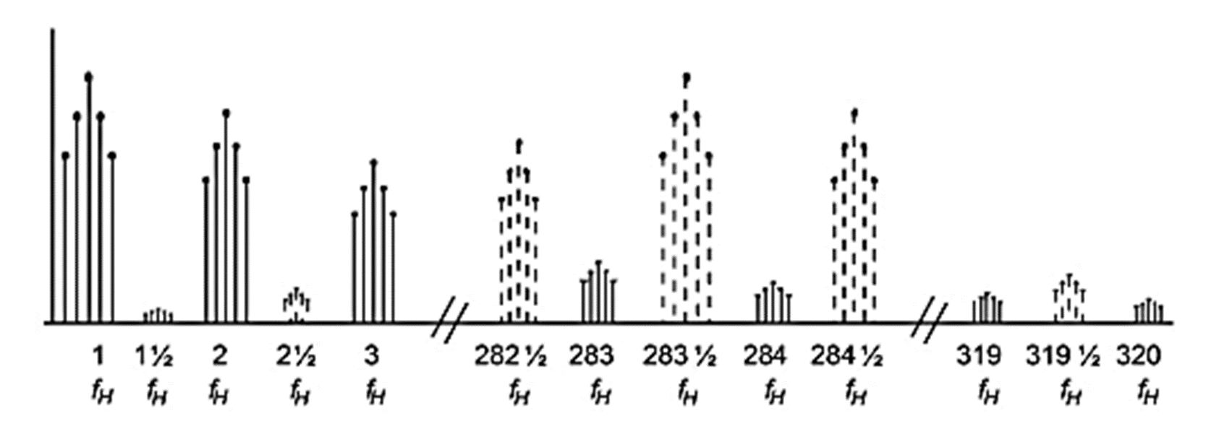
Interleaving of luminance and chroma signals

Slide 53
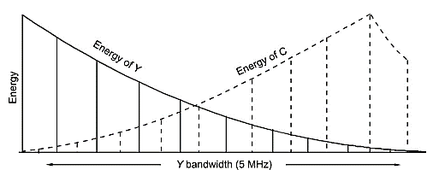
High subcarrier frequency makes the interleaving process free of cross interference.
Where the energy of Y signal is high, the energy of C signal is low and vice versa, as shown in the figure below.
Variation in the intensity of the interleaved signals

Slide 54
Factors on Which Choice of Subcarrier Frequency Depends
Bandwidth of the luminance signal is 5 MHz in CCIR B system.
The subcarrier should be near the 5 MHz end because of the following reasons:
Interleaving of chroma signal is easy at high frequency end where luminance signal is minimum.
Reduction of dot pattern when colour transmission is received in a monochrome receiver
Reduction of dot pattern in colour receiver when chroma signal enters Y channel due to insufficiency of the notch filter used to separate the two

